Slide 1
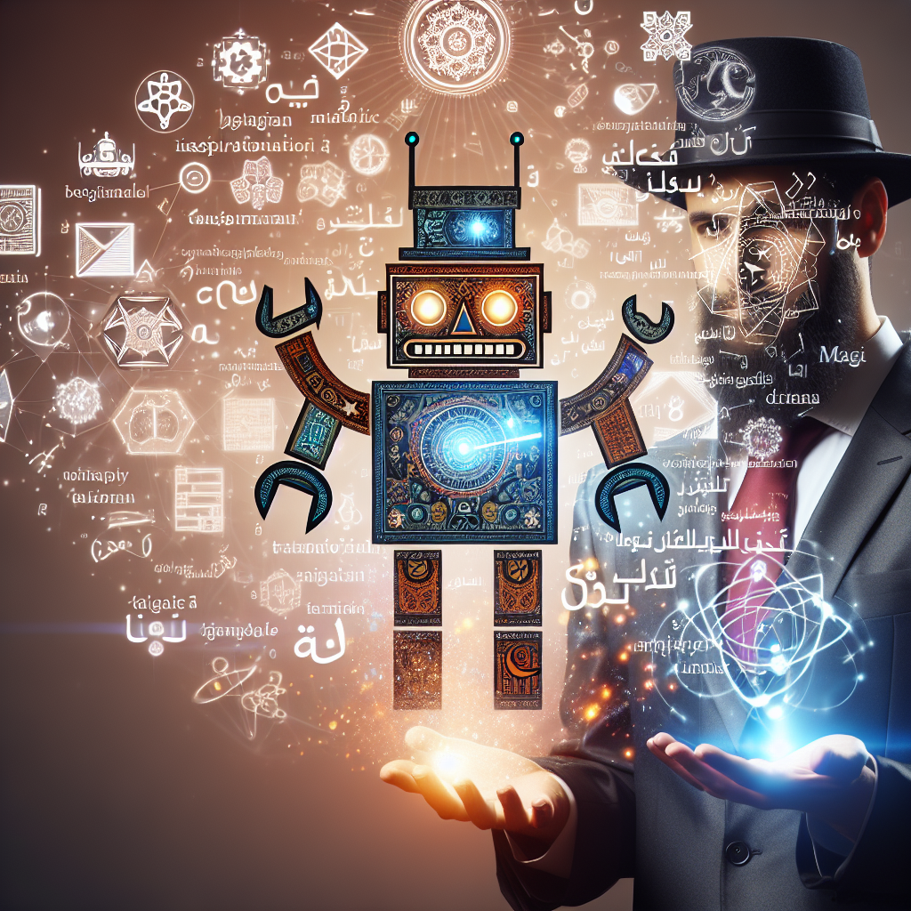
Understanding Transformers: The Magic Behind Modern Language Processing
Unveiling the Wizardry of Transformers in Language Processing

Slide 2
Understanding Transformers: The Magic Behind Modern Language Processing
Introduction
Transformers are a type of neural network architecture that have revolutionized natural language processing. They are known for their ability to translate text, write poems, generate computer code, and tackle a wide range of language tasks by leveraging innovations like positional encodings and self-attention.

Slide 3
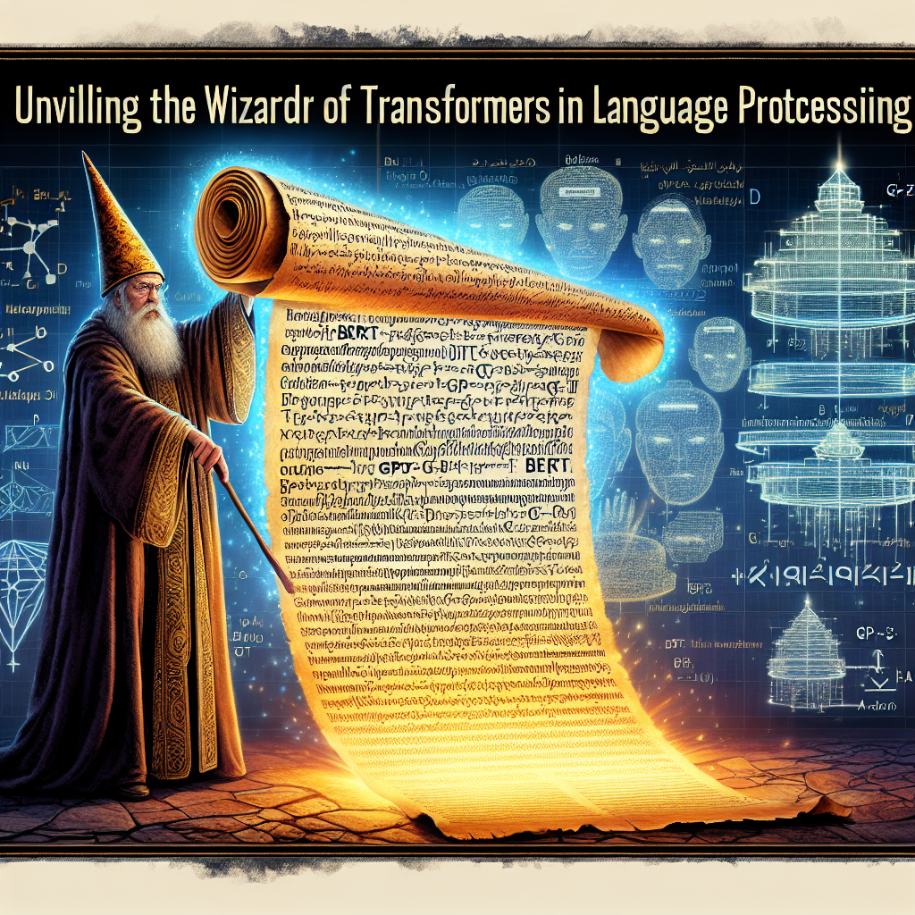
Understanding Transformers: The Magic Behind Modern Language Processing
Transformers are a type of neural network architecture that has revolutionized machine learning, particularly in natural language processing.
Prior to transformers, Recurrent Neural Networks (RNNs) were used for language tasks but had limitations in handling large text sequences effectively.
Models like BERT, GPT-3, and T5 are based on transformers and have shown immense success in tasks like translation, text generation, and more.

Slide 4
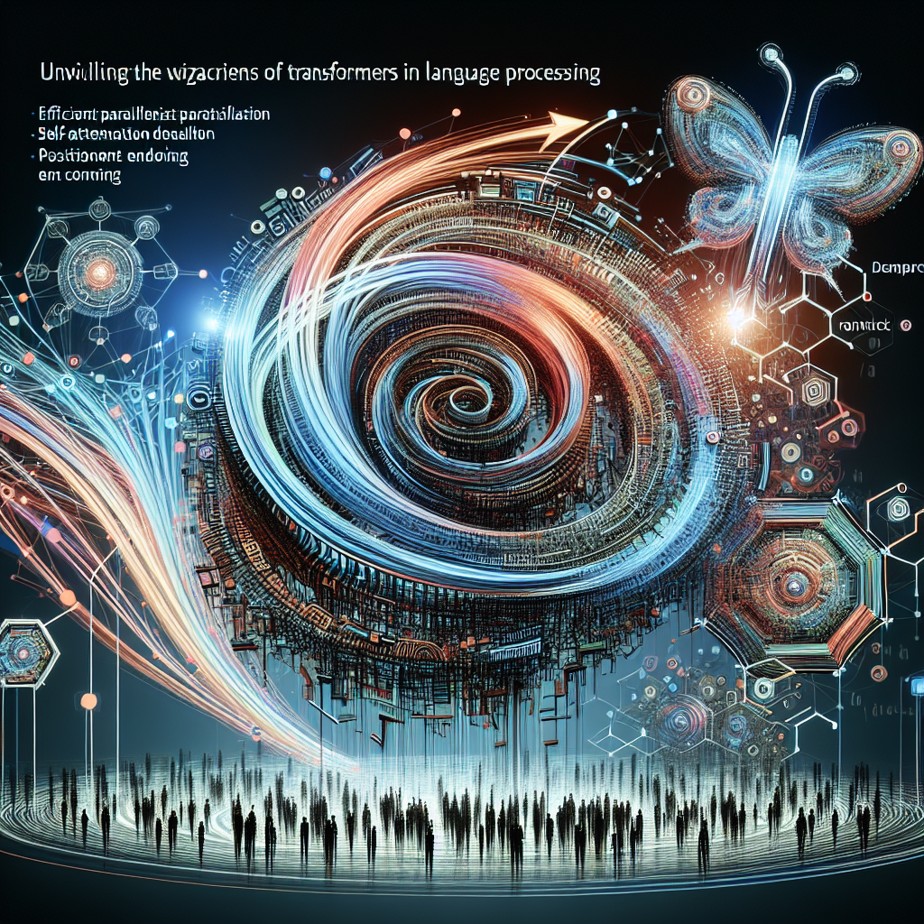
Understanding Transformers: The Magic Behind Modern Language Processing
Transformers were developed in 2017 to address the inefficiencies of training models like recurrent neural networks, enabling efficient parallelization and training on large datasets.
Positional encodings and attention mechanisms, including self-attention, are key innovations that contribute to the success of transformers in understanding word order and context.
Attention mechanism is crucial for tasks like translation, as it allows the model to focus on relevant parts of the input sequence and consider dependencies between words.

Slide 5
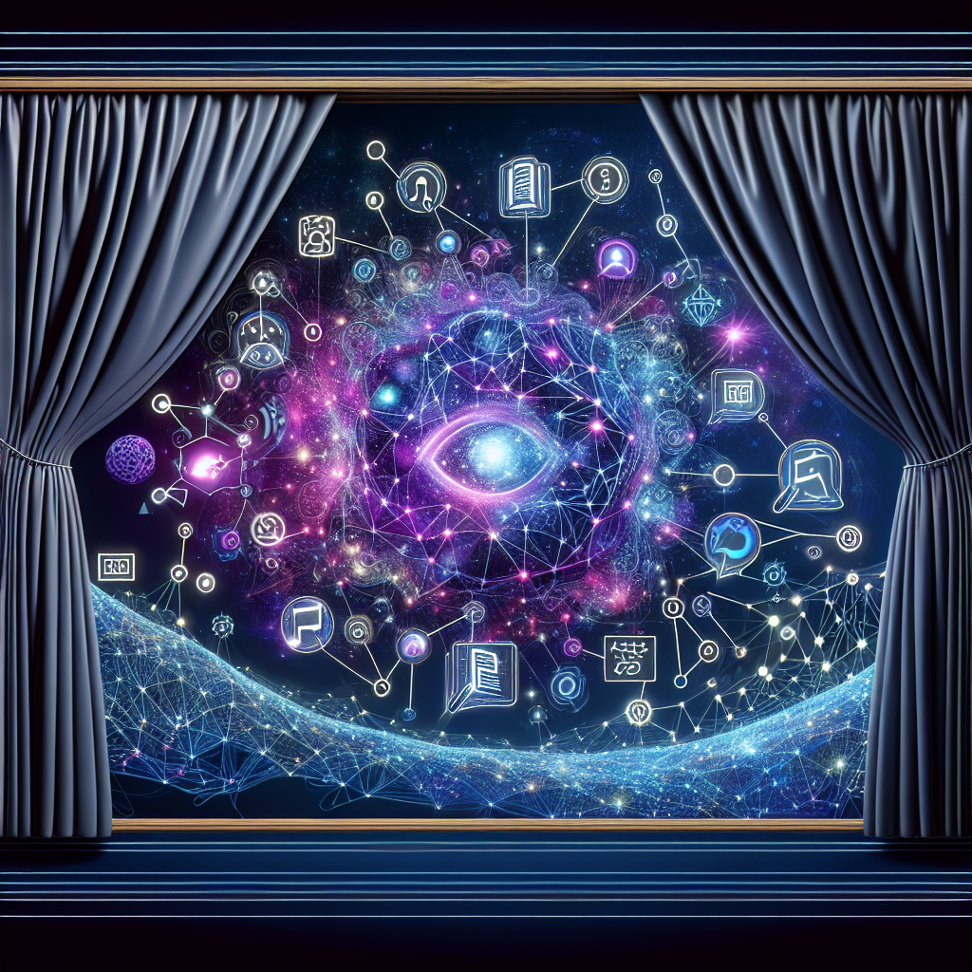
Understanding Transformers: The Magic Behind Modern Language Processing
Neural networks like transformers learn about language through analyzing text data
Self-attention allows neural networks to understand words in context
Attention mechanisms help neural networks disambiguate words, recognize parts of speech, and identify word tense

Slide 6
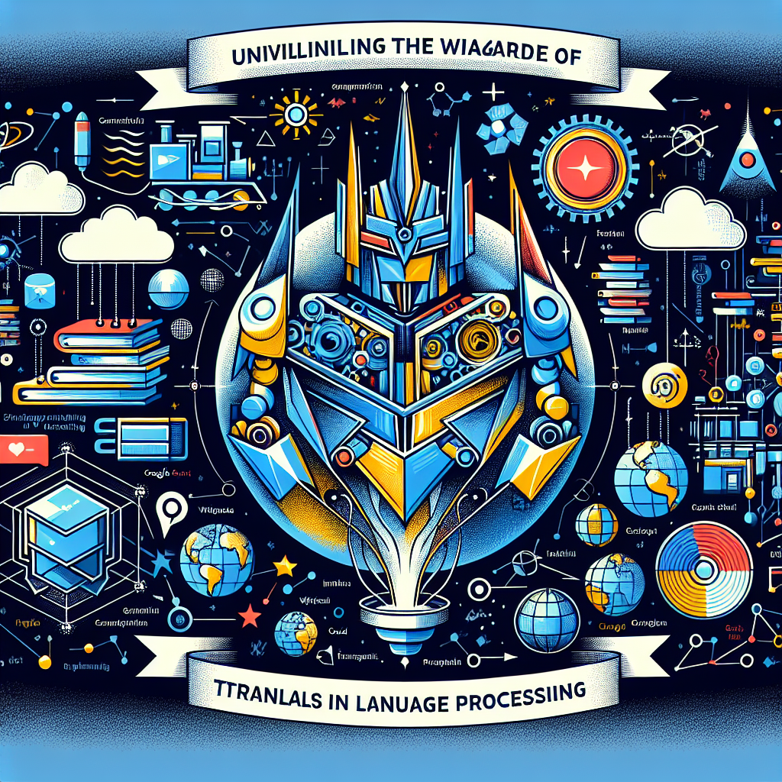
Understanding Transformers: The Magic Behind Modern Language Processing
BERT is a popular transformer-based model that can be adapted to various tasks in natural language processing, such as text summarization, question answering, classification, and finding similar sentences.
BERT is used in Google Search to understand search queries and powers Google Cloud's NLP tools, like Google Cloud AutoML Natural Language, showcasing its practical applications in real-world scenarios.
Transformers have proven effective in building high-quality models on unlabeled data, such as text scraped from sources like Wikipedia or Reddit, through semi-supervised learning, which is currently a significant trend in machine learning.

Slide 7
Understanding Transformers: The Magic Behind Modern Language Processing
Conclusion
The video explains how transformers have revolutionized machine learning, particularly in natural language processing. These neural networks process words in parallel, replacing the limitations of RNNs. Transformers like BERT are essential for language tasks and have shown impressive results in training models on large text datasets. They use self-attention to understand language, make accurate translations, and perform tasks like text summarization and question answering effectively. Pretrained transformer models like BERT are easily accessible and widely used in various applications.

Slide 8
Thanks

